Slide 1


Nano Server Administration
Thorsten Butz
Notes:
PowerShell Conference Europe
Hannover, 2016
www.psconf.eu

Slide 2





# about_me
$speaker = @{
name='Thorsten Butz'
jobrole = 'Trainer','Consultant','Author'
certification = 'MC*','LPIC-2'
= @thorstenbutz
= gplus.to/thorstenbutz
= facebook.com/thbutz
= thorsten-butz.de
= slidingwindows.de
}
Notes:
_____________________________________________________________________________________________________________________
_____________________________________________________________________________________________________________________
_____________________________________________________________________________________________________________________
_____________________________________________________________________________________________________________________
_____________________________________________________________________________________________________________________
_____________________________________________________________________________________________________________________
_____________________________________________________________________________________________________________________
_____________________________________________________________________________________________________________________
_____________________________________________________________________________________________________________________

Slide 3
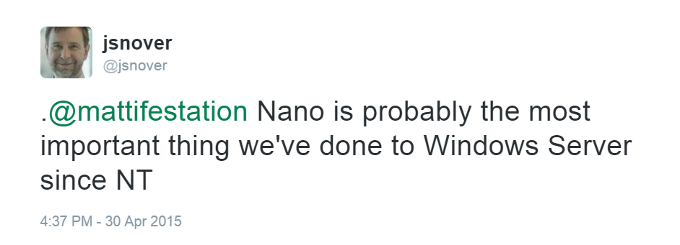
Notes:
https://twitter.com/jsnover/status/593786221404422144

Slide 4

Codename Tuva
Install.wim: 134 MB
Headless server
Zero foot print: no built-in roles or features
Purpose:
"Compute clusters" (Hyper-V-Host, Storage: SoFS, etc)
"Born-in-the-cloud”-Applications (Support for Ruby, Python, NoJS, etc)
Later/"next 20 years": Everything
*
*
WS 2016, TP 4
Notes:
"The Tyva Republic (Russian: Респу́блика Тыва́, tr. Respublika Tyva; IPA: [rʲɪˈspublʲɪkə tɨˈva]; Tuvan: Тыва Республика,Tyva Respublika, [təˈvɑ risˈpublikɑ]), Tyva or Tuva (Tuvan: Тыва, Russian: Тува́), is a federal subject of Russia (a republic, also defined in the Constitution of the Russian Federation as a state ^{[12]}). It lies in the geographical center of Asia, in southern Siberia. The republic borders the Altai Republic, the Republic of Khakassia, Krasnoyarsk Krai, Irkutsk Oblast, and the Republic of Buryatia in Russia and Mongolia to the south. Its capital is the city of Kyzyl. Population: 307,930 (2010 Census).^{[7]}
From 1921 until 1944, Tuva constituted a sovereign, independent nation, under the name of Tannu Tuva, officially, the Tuvan People's Republic, or the People's Republic of Tannu Tuva."
Size: 170,500 km²
Population: 307,930
https://en.wikipedia.org/wiki/Tuva
The 20 smalles countries in the world:
http://www.worldatlas.com/articles/the-10-smallest-countries-in-the-world.html
No1: Vatican – 0.44 km²
Population: 690

Slide 5
Evolution of Windows Server UI
Desktop Experience | Since WS 2008
GUI Shell
Minimal Server Interface | WS 2012 (R2), removed in WS 2016
Server Core | Since WS 2008
Notes:
_____________________________________________________________________________________________________________________
_____________________________________________________________________________________________________________________
_____________________________________________________________________________________________________________________
_____________________________________________________________________________________________________________________
_____________________________________________________________________________________________________________________
_____________________________________________________________________________________________________________________
_____________________________________________________________________________________________________________________
_____________________________________________________________________________________________________________________
_____________________________________________________________________________________________________________________

Slide 6
Evolution of Windows Server UI
Desktop Experience | Since WS 2008
GUI Shell
Minimal Server Interface | WS 2012 (R2), removed in WS 2016
Server Core | Since WS 2008
Desktop Experience | Since WS 2008
GUI Shell
Minimal Server Interface | WS 2012 (R2), removed in WS 2016
Server Core | Since WS 2008
Nano | New in WS 2016
Notes:
_____________________________________________________________________________________________________________________
_____________________________________________________________________________________________________________________
_____________________________________________________________________________________________________________________
_____________________________________________________________________________________________________________________
_____________________________________________________________________________________________________________________
_____________________________________________________________________________________________________________________
_____________________________________________________________________________________________________________________
_____________________________________________________________________________________________________________________
_____________________________________________________________________________________________________________________

Slide 7

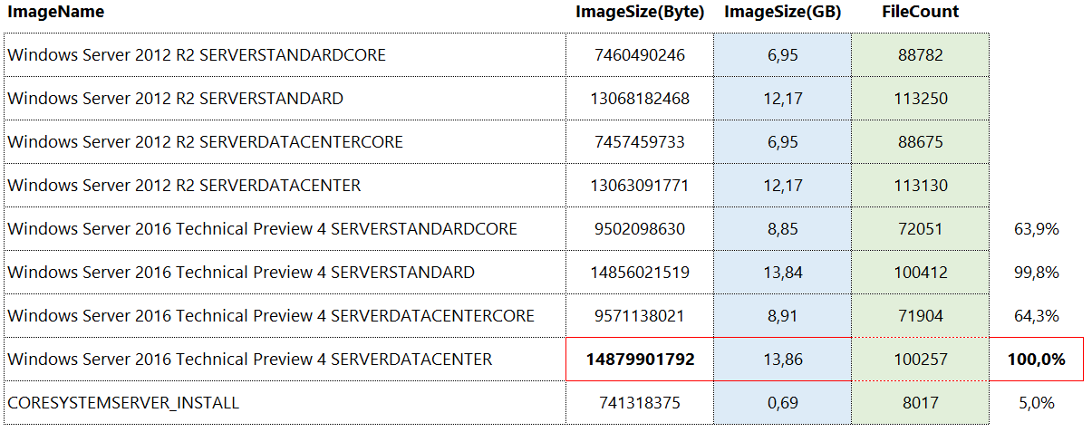
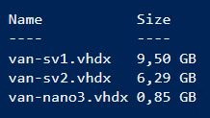
Footprints
Notes:
_____________________________________________________________________________________________________________________
_____________________________________________________________________________________________________________________
_____________________________________________________________________________________________________________________
_____________________________________________________________________________________________________________________
_____________________________________________________________________________________________________________________
_____________________________________________________________________________________________________________________
_____________________________________________________________________________________________________________________
_____________________________________________________________________________________________________________________
_____________________________________________________________________________________________________________________

Slide 8

Tuva:
170,500 km²
307.930 residents
Vatican: 0.44 km²
690 residents
Notes:
Photo (By Diliff - Own work, CC BY-SA 3.0)
https://commons.wikimedia.org/w/index.php?curid=2065989

Slide 9
# BUILD YOUR FIRST NANO SERVER
# GEN 1-VM => *.vhd
# Gen 2-VM => *.vhdx
Import-Module NanoServerImageGenerator.psm1 # from WS2016-ISO
$nanoName = 'sea-nano1'
New-NanoServerImage `
-MediaPath $iso_x `
-BasePath 'C:\NanoServer_TP4\Base' `
-TargetPath "C:\Hyper-V\Virtual Hard Disks\$nanoName.vhd" `
-GuestDrivers `
-EnableRemoteManagementPort `
-AdministratorPassword $password `
-Language en-US `
-ComputerName $nanoname
Notes:
_____________________________________________________________________________________________________________________
_____________________________________________________________________________________________________________________
_____________________________________________________________________________________________________________________
_____________________________________________________________________________________________________________________
_____________________________________________________________________________________________________________________
_____________________________________________________________________________________________________________________
_____________________________________________________________________________________________________________________
_____________________________________________________________________________________________________________________
_____________________________________________________________________________________________________________________

Slide 10
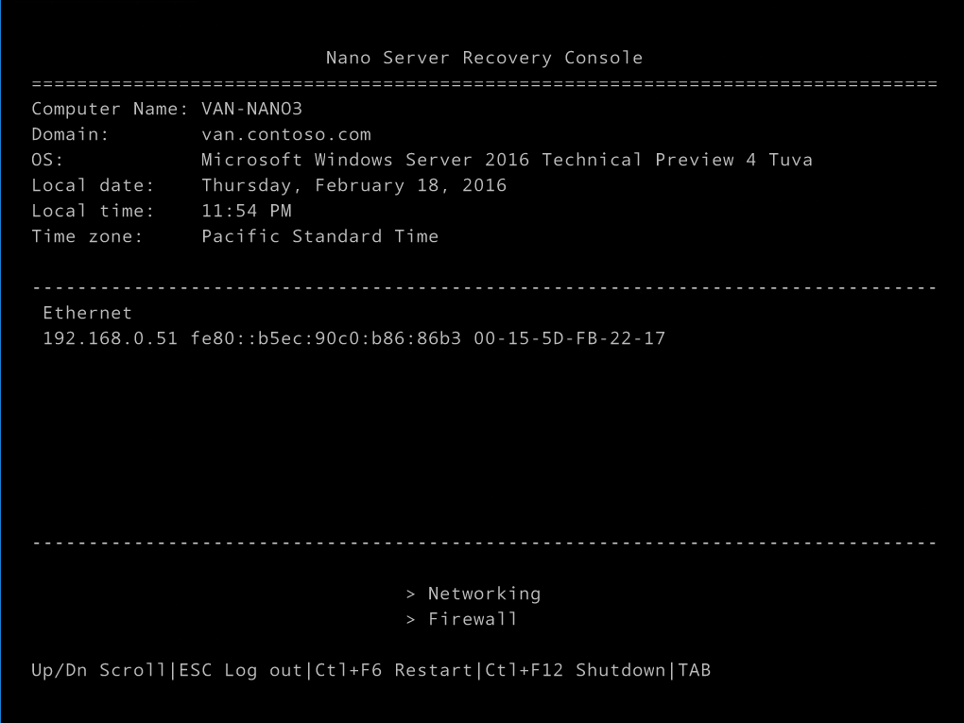
Recovery console
Notes:
_____________________________________________________________________________________________________________________
_____________________________________________________________________________________________________________________
_____________________________________________________________________________________________________________________
_____________________________________________________________________________________________________________________
_____________________________________________________________________________________________________________________
_____________________________________________________________________________________________________________________
_____________________________________________________________________________________________________________________
_____________________________________________________________________________________________________________________
_____________________________________________________________________________________________________________________

Slide 11
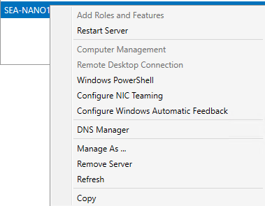
Workgroup vs. Domain
Workgroup
a) ConfigureTrustedHost list: Set-Item `
WSMan:\localhost\Client\TrustedHosts `
-Value 192.168.0.100 -Force
b) "Manage As …" from ServerManager
Domain PreCreate AD membership:
djoin.exe /Provision /Domain contoso
/Machine "sea-nano1" /SaveFile "c:\depot\sea-nano1.djoin"
Notes:
_____________________________________________________________________________________________________________________
_____________________________________________________________________________________________________________________
_____________________________________________________________________________________________________________________
_____________________________________________________________________________________________________________________
_____________________________________________________________________________________________________________________
_____________________________________________________________________________________________________________________
_____________________________________________________________________________________________________________________
_____________________________________________________________________________________________________________________
_____________________________________________________________________________________________________________________

Slide 12
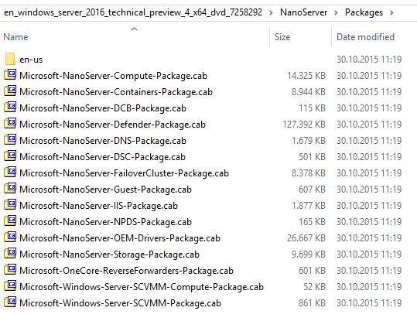
Running apps on Nano
Compatible API (subset)
Reverse Forwarders: "DLL shims" forward api calls to new DLLs (optional package)
Appx: Windows Server App (WSA) Installer, no MSI support
"Built-In" roles: optional package
Notes:
When used in any of these configuration Nano Server has the same API surface available for running applications. The Nano Server API surface is a subset of what is available in Server Core and Server with a Desktop Experience. As a subset, any application, tool, or agent that is written to run on Nano Server will run without modification on Server Core or Server with a Desktop Experience.

Slide 13
New-NanoServerImage –Packages Microsoft-NanoServer-DNS-Package […]
New-NanoServerImage –Compute […]
Notes:
Packages with explicit parameters (WS 2016, TP4)
-Compute (Microsoft-NanoServer-Compute-Package.cab)
-Containers (Microsoft-NanoServer-Containers-Package.cab)
-Defender (Microsoft-NanoServer-Defender-Package.cab)
-Clustering (Microsoft-NanoServer-FailoverCluster-Package.cab)
-GuestDrivers (Microsoft-NanoServer-Guest-Package.cab)
-OEMDrivers (Microsoft-NanoServer-OEM-Drivers-Package.cab)
-Storage (Microsoft-NanoServer-Storage-Package.cab)
-ReverseForwarders (Microsoft-OneCore-ReverseForwarders-Package.cab)
Packages installed via "-packages" (WS 2016, TP4)
-packages Microsoft-NanoServer-DCB-Package.cab
-packages Microsoft-NanoServer-DNS-Package.cab
-packages Microsoft-NanoServer-DSC-Package.cab
-packages Microsoft-NanoServer-IIS-Package.cab
-packages Microsoft-NanoServer-NPDS-Package.cab
-packages Microsoft-Windows-Server-SCVMM-Compute-Package.cab
-packages Microsoft-Windows-Server-SCVMM-Package.cab

Slide 14
Demo
Build NANO server,
configure NANO server
Notes:
_____________________________________________________________________________________________________________________
_____________________________________________________________________________________________________________________
_____________________________________________________________________________________________________________________
_____________________________________________________________________________________________________________________
_____________________________________________________________________________________________________________________
_____________________________________________________________________________________________________________________
_____________________________________________________________________________________________________________________
_____________________________________________________________________________________________________________________
_____________________________________________________________________________________________________________________

Slide 15
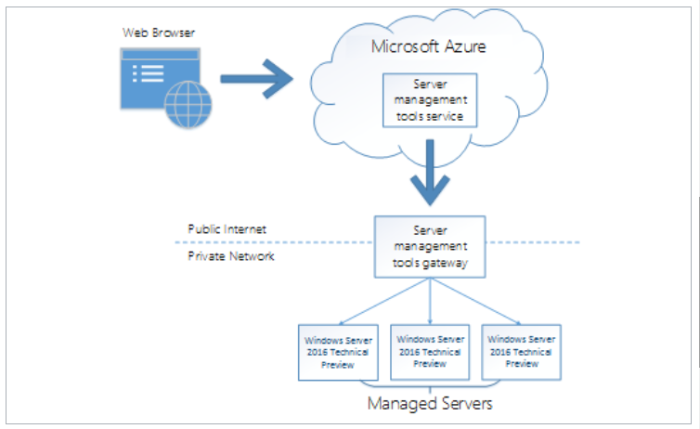
Remote Server Mgmt Tools
Notes:
http://blogs.technet.com/b/nanoserver/archive/2016/02/09/server-management-tools-is-now-live.aspx

Slide 16
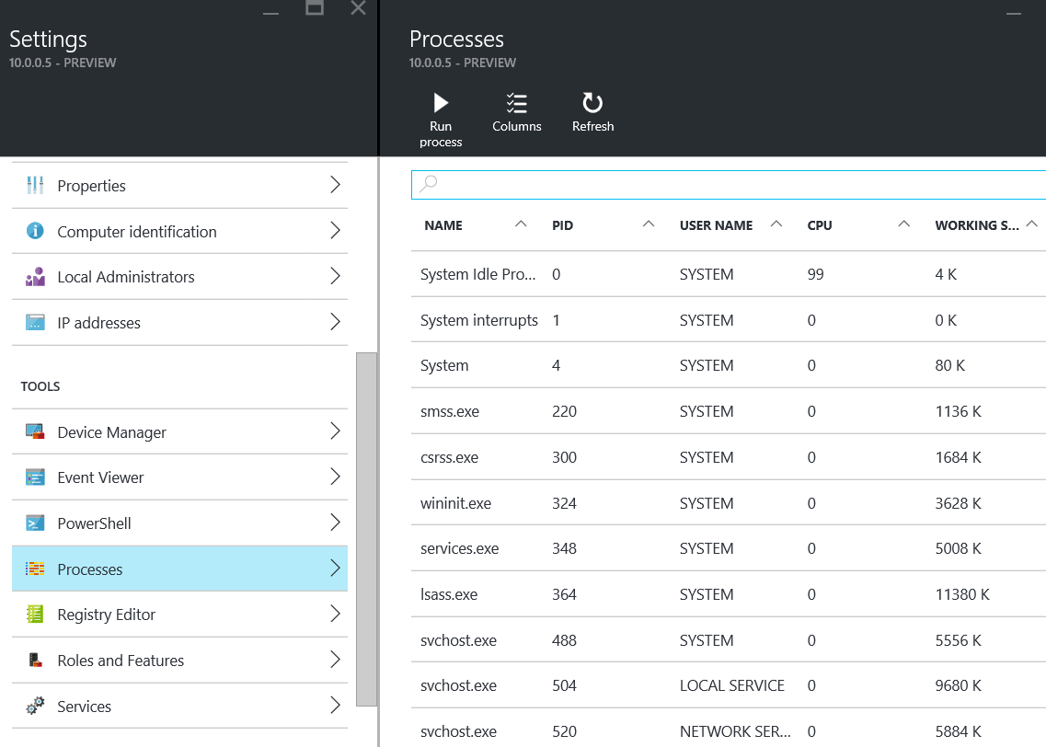
RSMT: Processes
Notes:
http://blogs.technet.com/b/nanoserver/archive/2016/02/09/server-management-tools-is-now-live.aspx

Slide 17
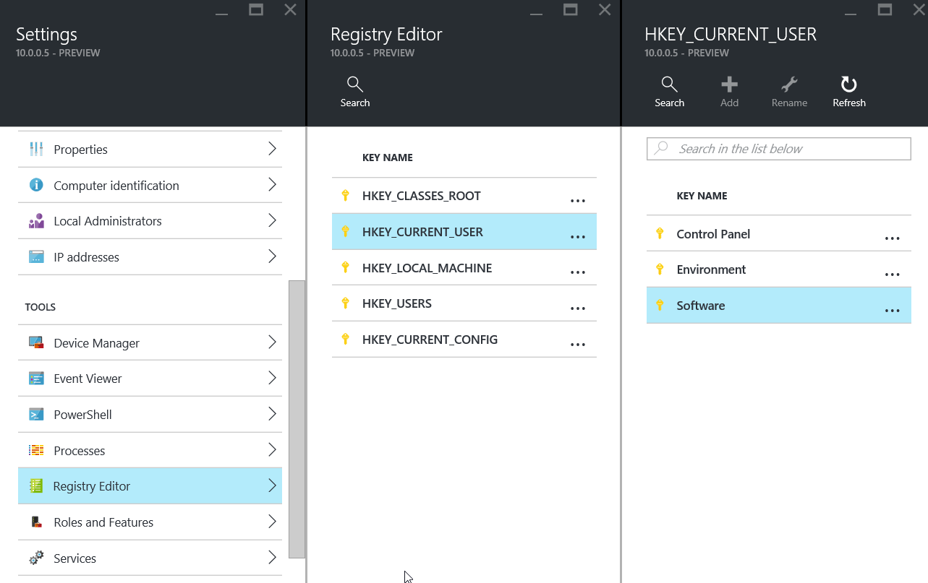
RSMT: Regedit
Notes:
http://blogs.technet.com/b/nanoserver/archive/2016/02/09/server-management-tools-is-now-live.aspx

Slide 18
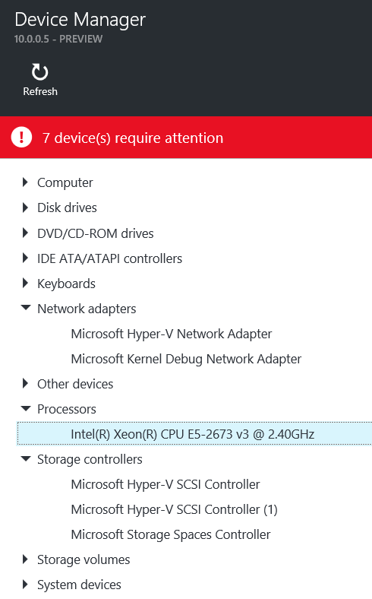
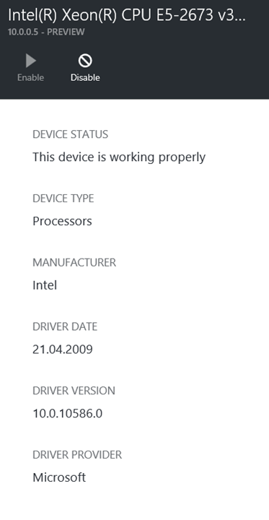
RSMT: DevMgmt
Notes:
http://blogs.technet.com/b/nanoserver/archive/2016/02/09/server-management-tools-is-now-live.aspx

Slide 19
Shadows of the past
The legacy of Windows Server | The future of Windows Server
MMC.EXE compmgmt.msc, dsa.msc, dnsmgmt.msc … RPC/DCOM WMI NetBT RDP | WinRM Web-based mgmt: Remote Server Management Tools (RSMT) Open-SSL support
Notes:
_____________________________________________________________________________________________________________________
_____________________________________________________________________________________________________________________
_____________________________________________________________________________________________________________________
_____________________________________________________________________________________________________________________
_____________________________________________________________________________________________________________________
_____________________________________________________________________________________________________________________
_____________________________________________________________________________________________________________________
_____________________________________________________________________________________________________________________
_____________________________________________________________________________________________________________________

Slide 20
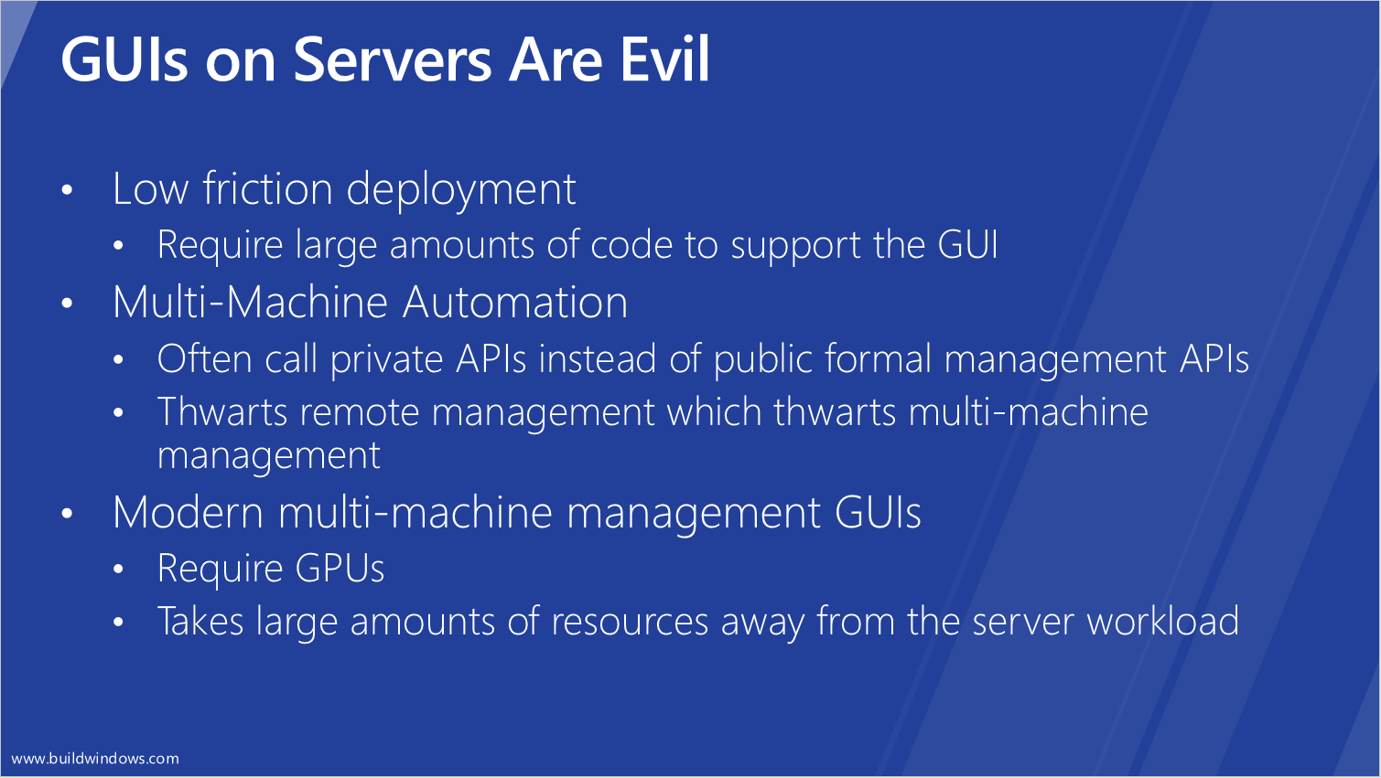
build 2011
Notes:
Jeffrey Snover, Andrew Mason (Build 2011)
"Windows Server 8 apps must run without a GUI"
https://channel9.msdn.com/Events/BUILD/BUILD2011/SAC-416T
Slides:
http://video.ch9.ms/build/2011/slides/SAC-416T_Mason.pptx

Slide 21
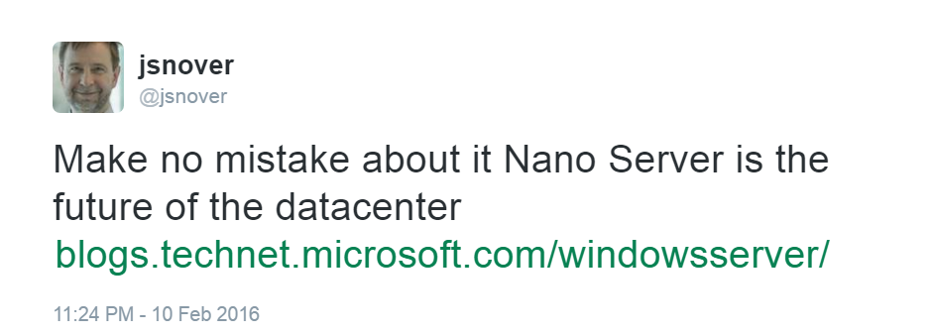
Notes:
https://twitter.com/jsnover/status/697546729466392576
https://blogs.technet.microsoft.com/windowsserver/2016/02/10/exploring-nano-server-for-windows-server-2016/

Slide 22
Questions?
@thorstenbutz
Notes:
_____________________________________________________________________________________________________________________
_____________________________________________________________________________________________________________________
_____________________________________________________________________________________________________________________
_____________________________________________________________________________________________________________________
_____________________________________________________________________________________________________________________
_____________________________________________________________________________________________________________________
_____________________________________________________________________________________________________________________
_____________________________________________________________________________________________________________________
_____________________________________________________________________________________________________________________

Slide 23
Thank you!
@thorstenbutz
Notes:
_____________________________________________________________________________________________________________________
_____________________________________________________________________________________________________________________
_____________________________________________________________________________________________________________________
_____________________________________________________________________________________________________________________
_____________________________________________________________________________________________________________________
_____________________________________________________________________________________________________________________
_____________________________________________________________________________________________________________________
_____________________________________________________________________________________________________________________
_____________________________________________________________________________________________________________________

